Slide 1

Grocery Store Management

Slide 2
About me
Pavani Munagala
I Completed my graduation in Biotechnology Engineering from National Institute of Technology Raipur in 2024, where I worked on a exciting project named “Detection of Cancer Cells Using Linear Regression Models”. That was a turning point for me, as it sparked a deep interest in the field of data driven research and AI.
As I delved deeper into this project, I became fascinated by how machine learning could be applied to solve real -world biological problems. It was through this exposure that I realized my passion for Data Science a field that is not only booming today but also shaping the future across many industries.Motivated by this interest, I decided to pursue my career in Data Science.
Linkedin:www.linkedin.com/pavani-munagala
Github::https://github.com/Pavani-Reddy111

Slide 3
Agenda
Objective of the project
ER Diagram and schema explanation
Analysis
SQL queries
Business insights
Conclusion
Challenges

Slide 4
Objective of our project:
The main goals of this SQL project are:
To design and implement a relational database for a grocery store.
To retrieve and manipulate data using SQL queries.
To perform data analysis for business insights such as top customers, best-selling products, and revenue trends.
To practice using joins, aggregations, subqueries, and filtering techniques.

Slide 5
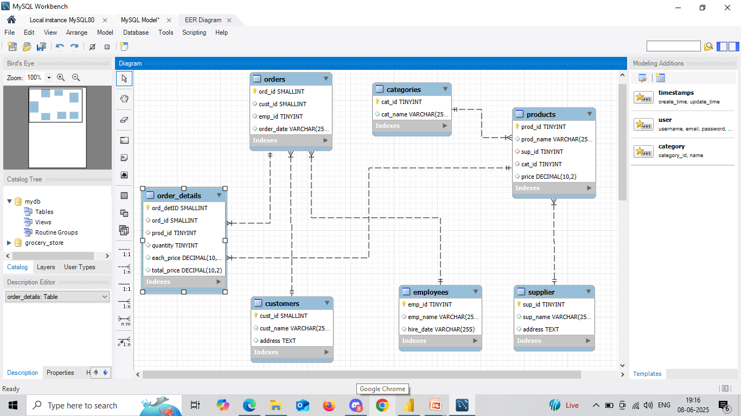
ER Diagram:

Slide 6
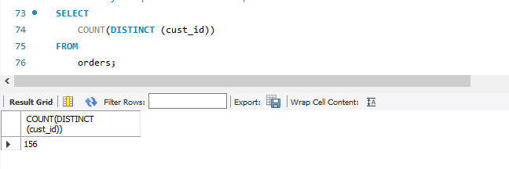
Analysis:
1. Customer Insights:
How many unique customers have placed orders?

Slide 7
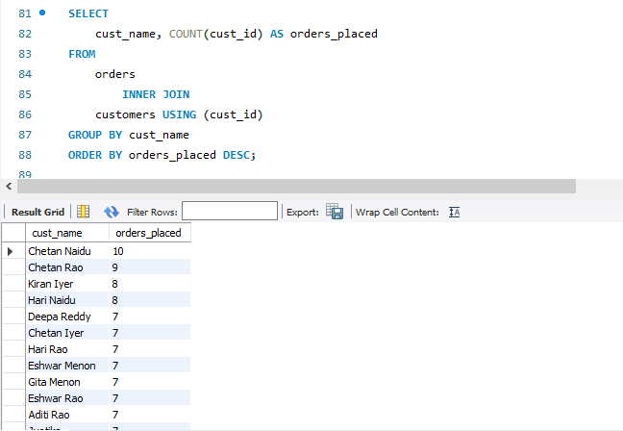
Which customers have placed the highest number of orders?

Slide 8
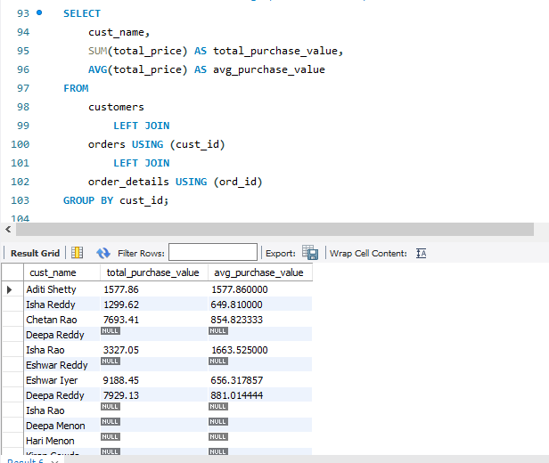
What is the total and average purchase value per customer?

Slide 9
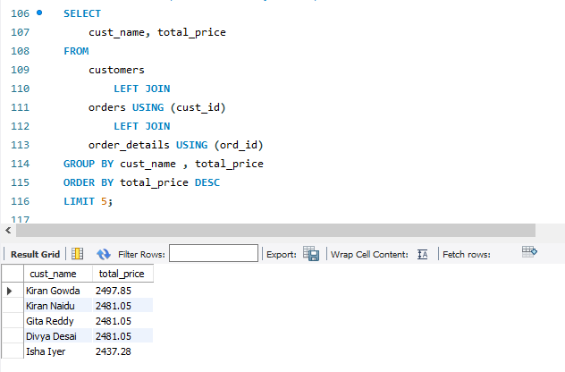
Who are the top 5 customers by total purchase amount?

Slide 10
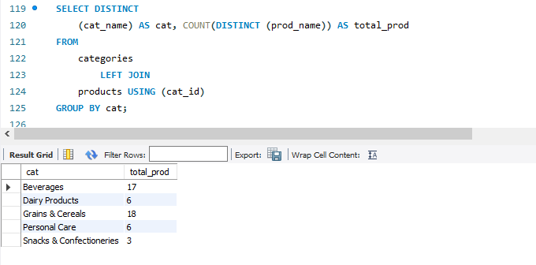
2. Product Performance
How many products exist in each category?

Slide 11
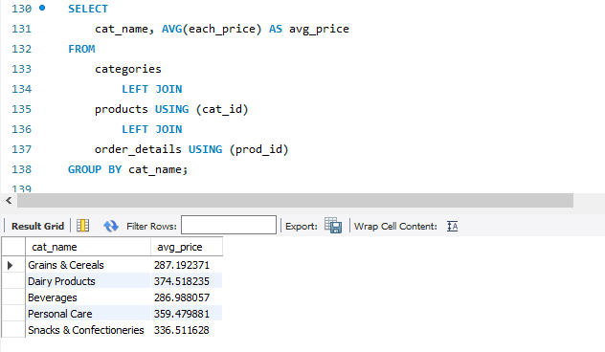
What is the average price of products by category?

Slide 12
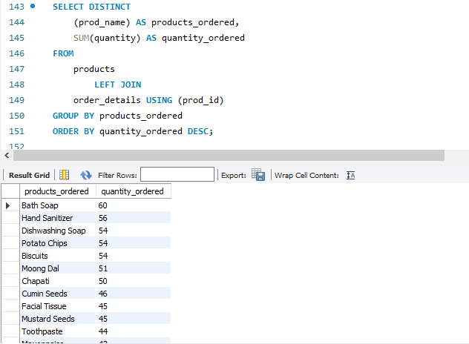
Which products have the highest total sales volume (by quantity)?

Slide 13
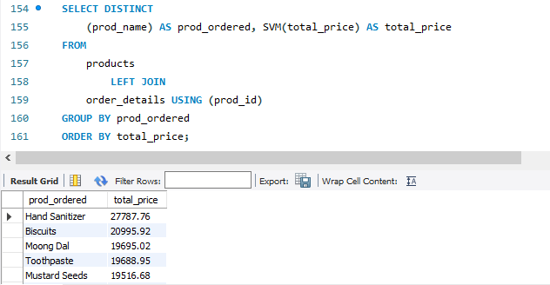
What is the total revenue generated by each product?

Slide 14
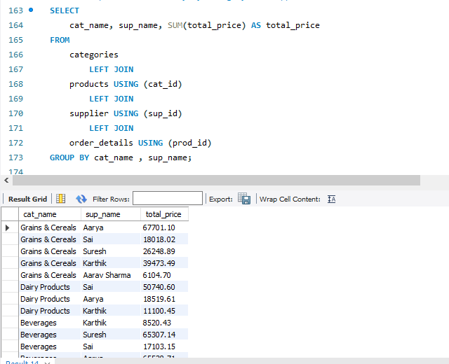
How do product sales vary by category and supplier?

Slide 15
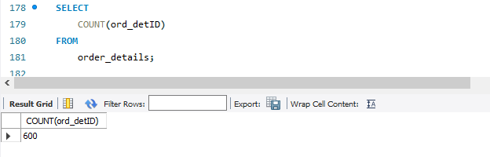
3. Sales and Order Trends
How many orders have been placed in total?

Slide 16
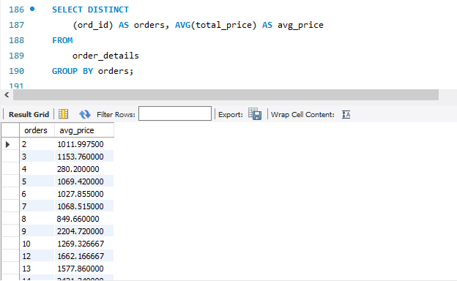
What is the average value per order?

Slide 17
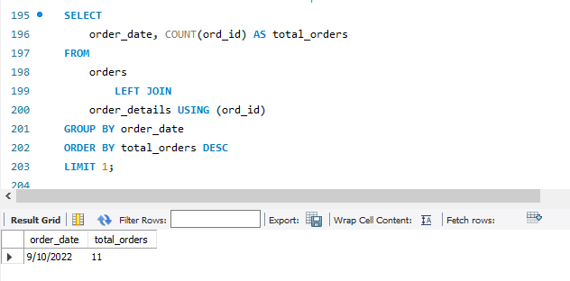
On which dates were the most orders placed?

Slide 18
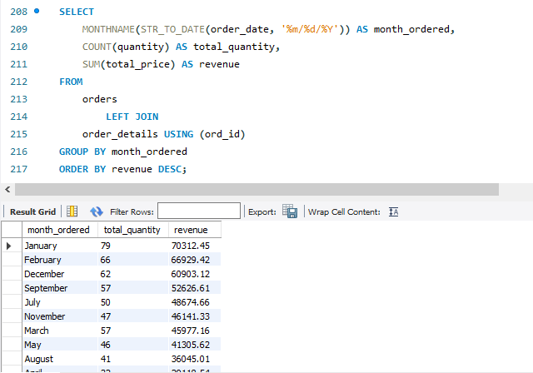
What are the monthly trends in order volume and revenue?

Slide 19
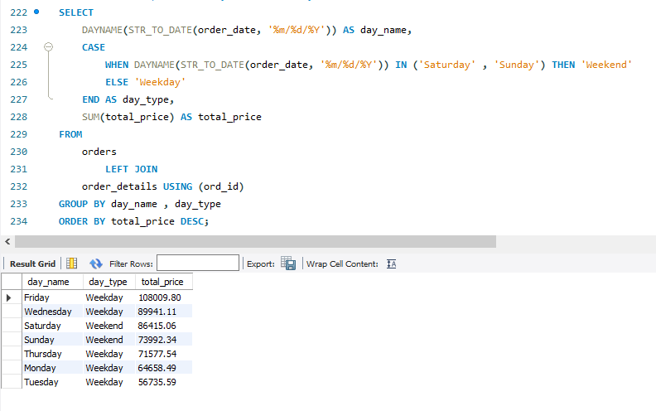
How do order patterns vary across weekdays and weekends?

Slide 20

4. Supplier Contribution
How many suppliers are there in the database?

Slide 21
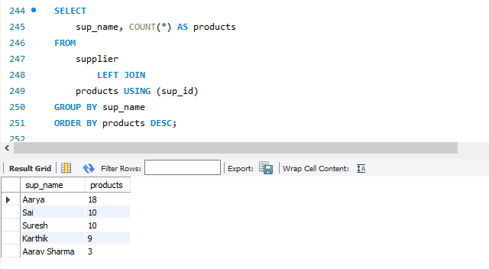
Which supplier provides the most products?

Slide 22

What is the average price of products from each supplier?

Slide 23
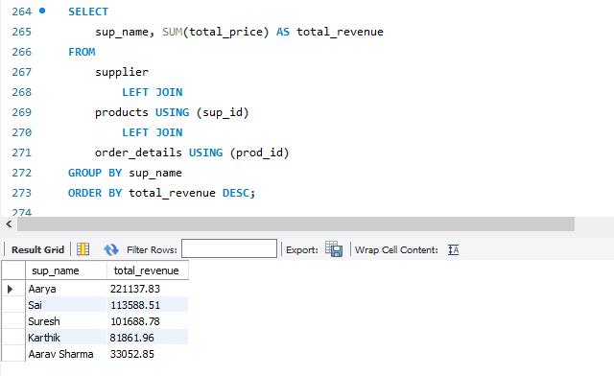
Which suppliers contribute the most to total product sales (by revenue)?

Slide 24
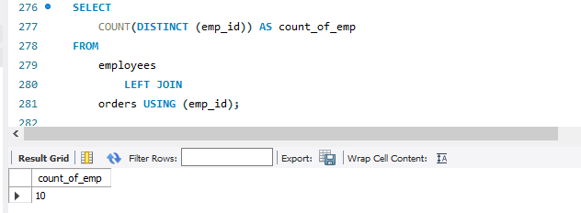
5. Employee Performance
. How many employees have processed orders?

Slide 25

Which employees have handled the most orders?

Slide 26
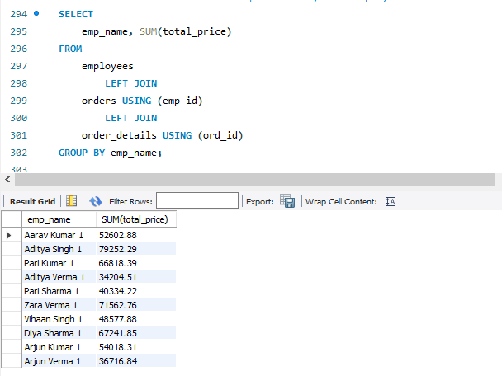
What is the total sales value processed by each employee?

Slide 27
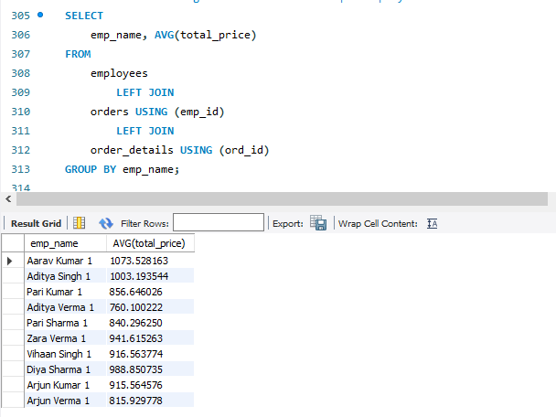
What is the average order value handled per employee?

Slide 28

6. Order Details Deep Dive
What is the relationship between quantity ordered and total price?

Slide 29
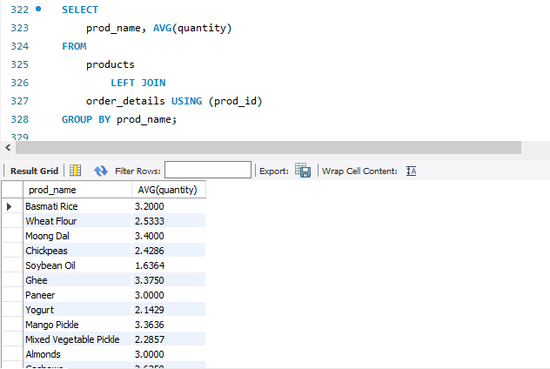
What is the average quantity ordered per product?

Slide 30
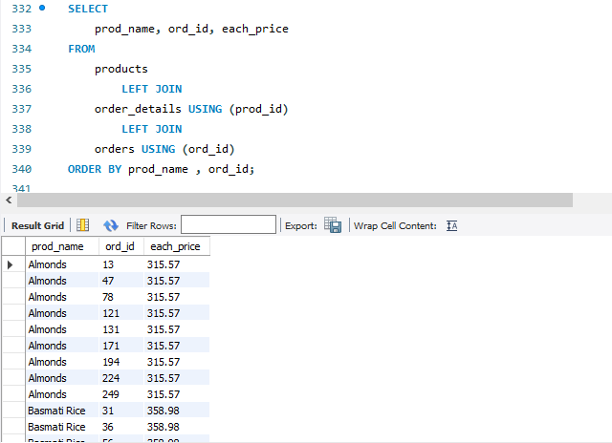
How does the unit price vary across products and orders?

Slide 31
Conclusion:
There are more products available in Grains & cereals and Beverages category.
Bath soaps and hand sanitizers are the products that ordered in high quantity.
Hand sanitizers and biscuits generated high revenue.
Totally 600 orders are placed by the customers.
January month have seen more no. of orders i.e. 79 and the revenue generated is 70,312.
Totally there are 5 suppliers.
Supplier named Aarya supplies most of the products and the revenue generated by this high i.e. 2,21,137.

Slide 32
Business Insights :
Less products available in snacks and confectioneries.
Beverages, Grains & Cereals generated less revenue though they are many products exists In this category.
October month generated least revenue and no. of products sold were 32.
Weekdays are experiencing more orders compared to weekends.
Soybean oil is ordered in less quantity.

Slide 33
Challenges:
Understanding table relationships and applying correct joins.
Ensuring data consistency with foreign key constraints.
Handling aggregation across joined tables.
Extracting time-based trends from date data (especially if in VARCHAR format).

Slide 34

THANK YOU

